Slide 1

LOCATION FORM
Team:
Divyaraj
Shreya
Priya
Parmeshwar
Sanatan

Slide 2
Problem Statement
Objective
Microservices
Project Overview
Onboarding-Architecture
Project Flow
Technology and Tools Used
Conclusion
Outline

Slide 3

Problem Statement
XYZ want to fill his information So with the help of this form he can easily fill that with this url
http://3.143.205.239:8095/show

Slide 4
Objective
Our objective is to provide best online location registration service to XYZ so that XYZ can Add, Update & Delete his location online without stepping outside.

Slide 5
Authentication API
Favourite API
Recommendation API
Microservices SpringBoot FrameWork Mysql DB

Slide 6
Project Overview

Slide 7
Project Overview
MySQL
Add Location
Location form
Show Locations
Update Data
Delete data

Slide 8
On boarding Architecture

Slide 9
Architecture
MySQL DB
Backend
SpringBoot FrameWork
java/Maven/JSTL
POST request
Add Location
Update
Front End
HTML/JSP
Update
Update
Delete
Delete
Retrieve
Retrieve

Slide 10
Project Flow

Slide 11
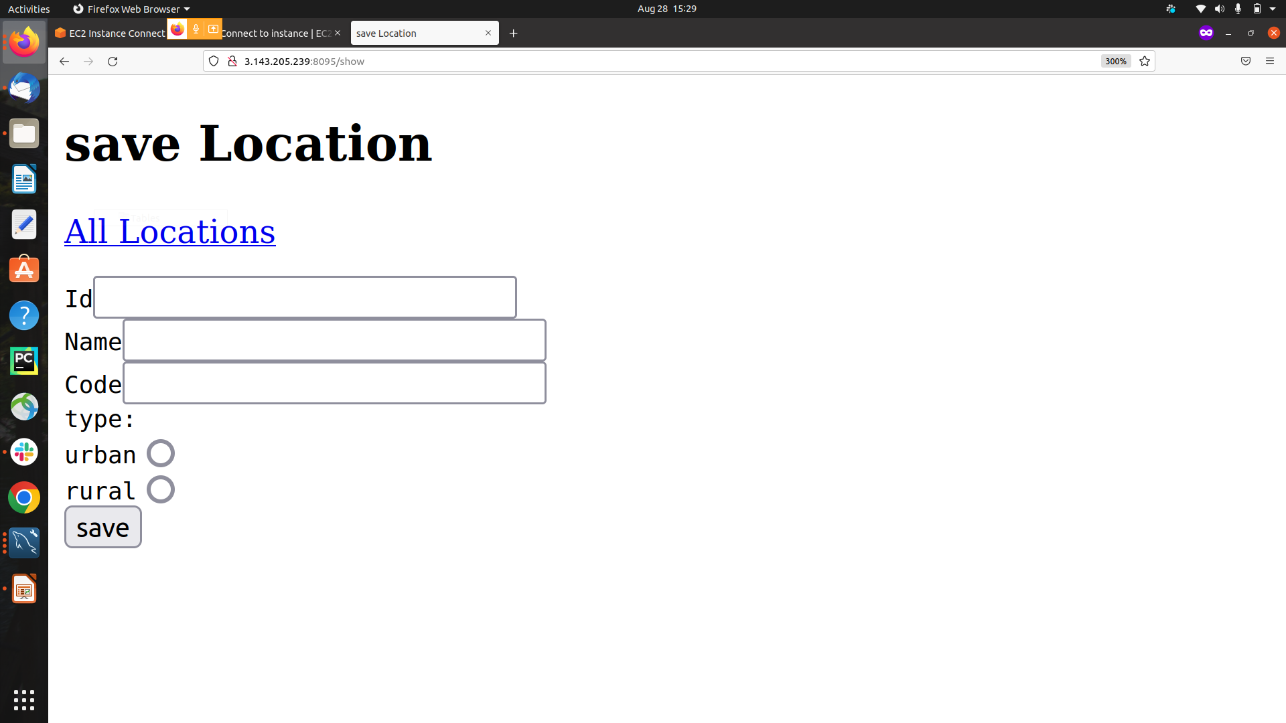
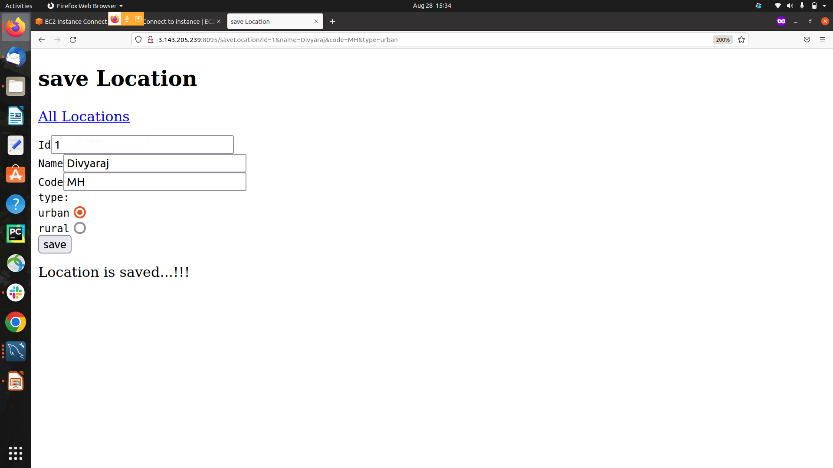

Slide 12
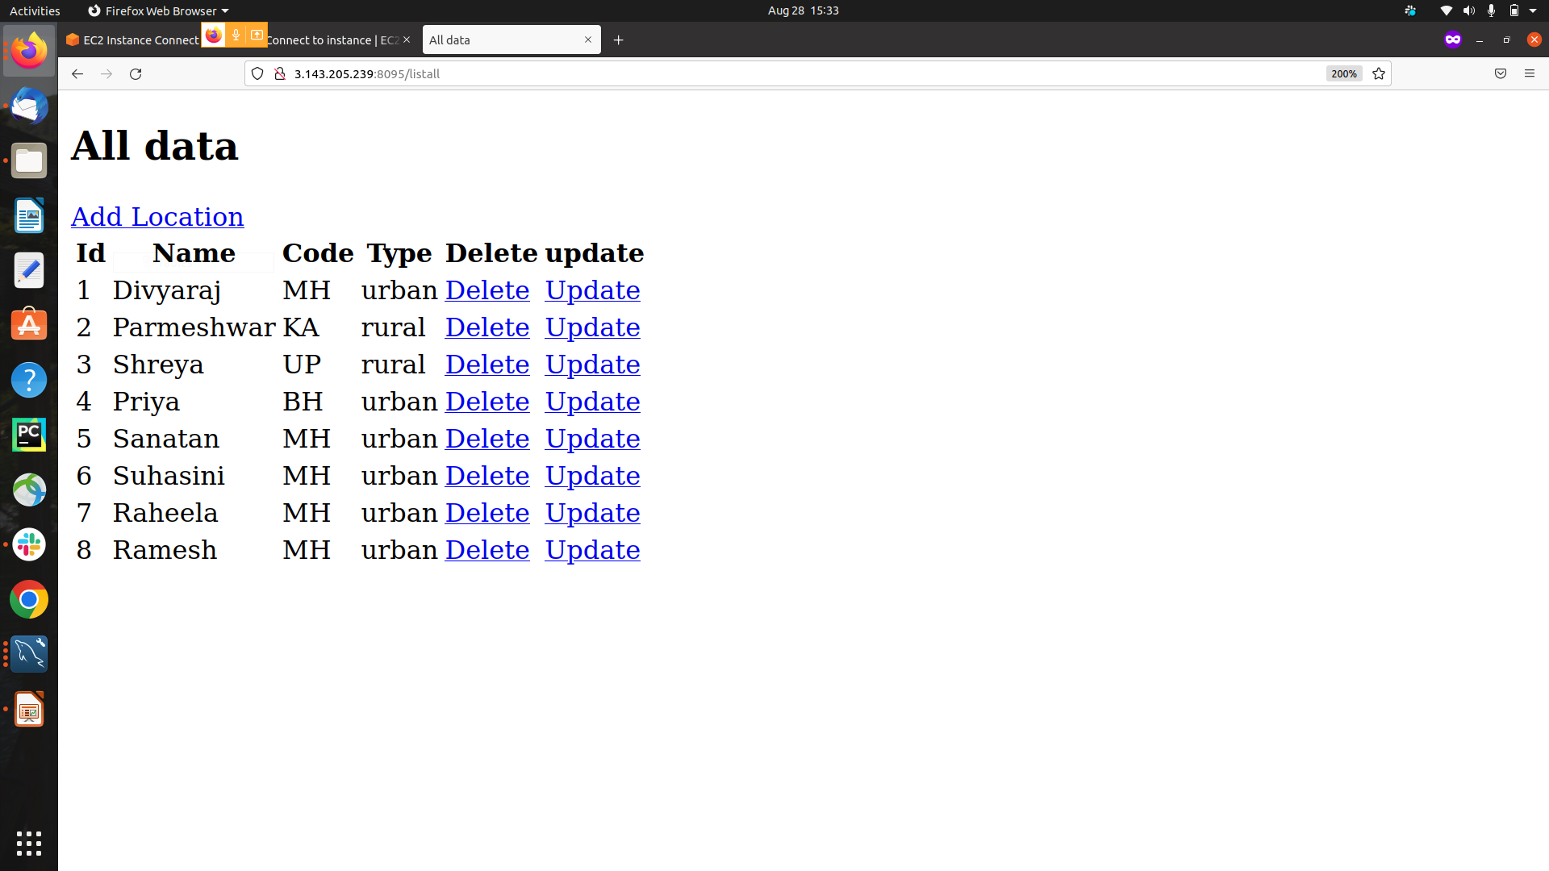

Slide 13
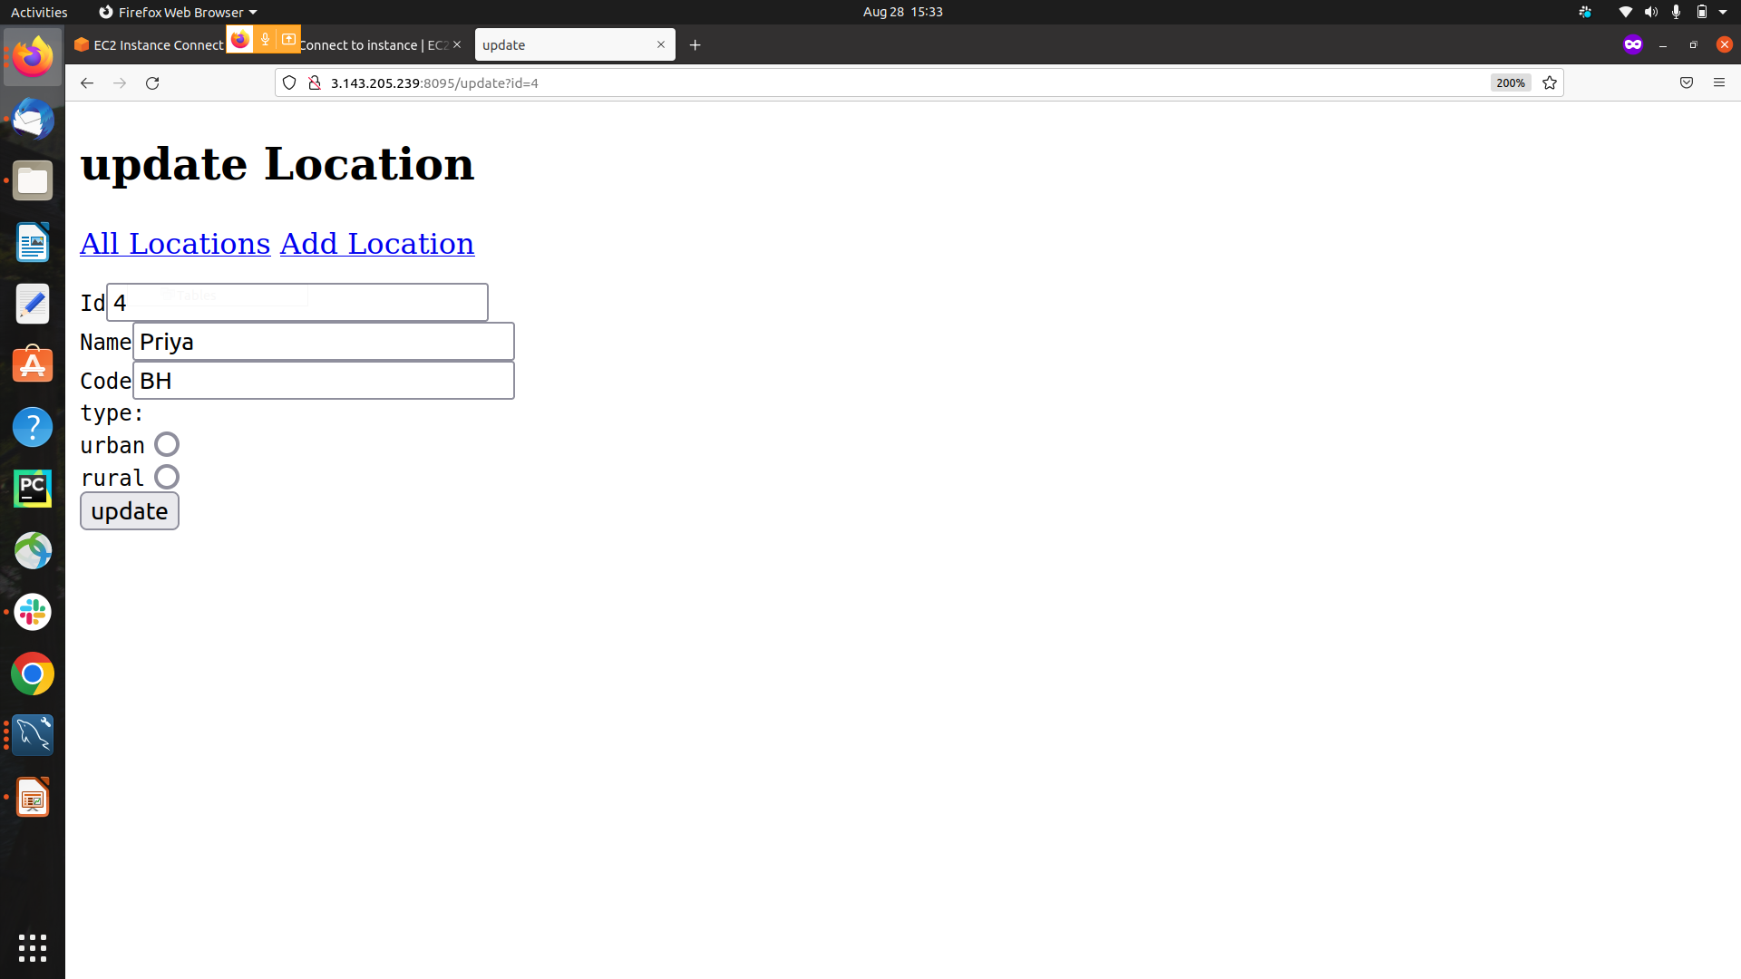
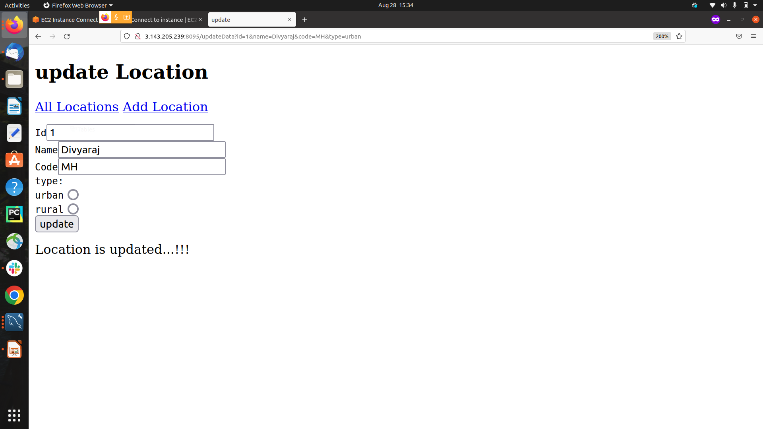

Slide 14








Technologies and Tools Used

Slide 15
Conclusion
This WebApplication is designed to help the user toAdd,Update,Retrieve & Delete user information from the location form.

Slide 16


